Slide 1
Frome Valley CE First School
Maths-tastic Quiz!

Slide 2
Number and Place Value
Reception: Which number comes next…
4, 5, 6, 7, ___ ?
Year 1: What number does this image show?

Slide 3
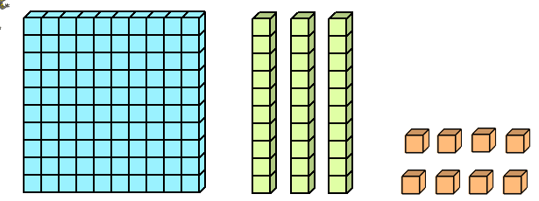
Number and Place Value
Year 2: Which number comes next in the sequence…
24, 34, 44, 54, ___ ?
Year 3: What number is represented by the dienes?

Slide 4
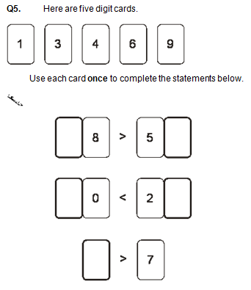
Number and Place Value
Year 4: What is 345 rounded to the nearest hundred?
Adult Question:

Slide 5
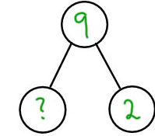
Calculating
Reception: Can you solve this problem?
Year 1:

Slide 6
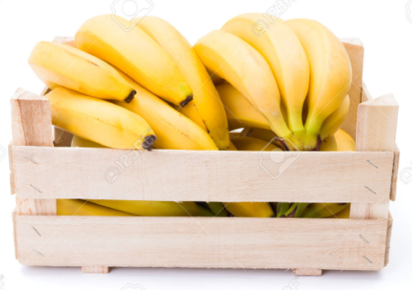
Calculating
Year 2: There are 21 bananas in a box.
I put in another 12 bananas. How
many bananas do I have now?

Slide 7
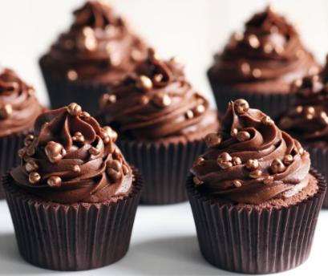
Calculating
Year 3: Tina has 37 cupcakes and Rich has 25 cupcakes. How many cupcakes altogether?

Slide 8
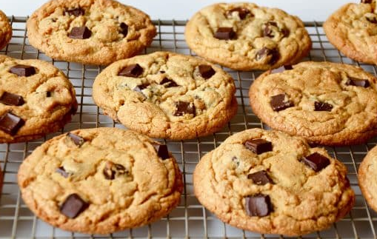
Calculating
Year 4: Lulu made 349 chocolate cookies and JoJo made 236 vanilla cookies. How many cookies were there altogether?

Slide 9
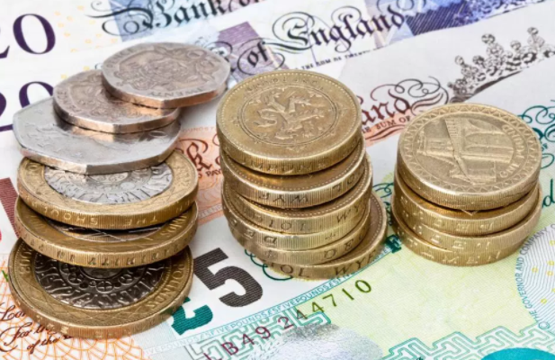
Calculating
Adult Question: Janet earns £65 in the first week, £74 in the second and £21 in the third. What is her total income?

Slide 10
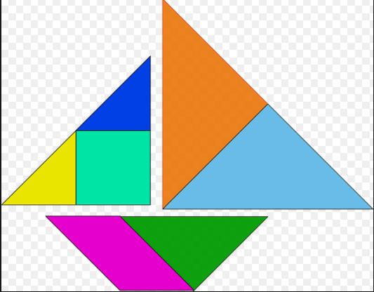
Tangram Challenge!
You have 1 min to solve the tangram in your envelope.

Slide 11
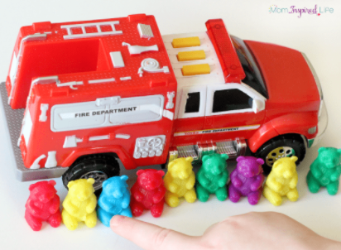
Measure
Reception: How many bears are the same length as this fire engine?

Slide 12
Measure
Year 1: Which coloured pencil is the longest?

Slide 13
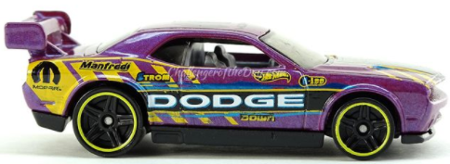
Measure
Year 2: What is the length of the toy car?

Slide 14
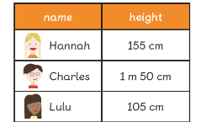
Measure
Year 3: One sticker is 2cm. What is the length of 8 stickers in a row?
Year 4: Which child
is the tallest?

Slide 15
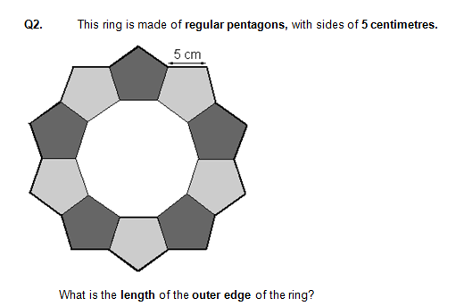
Measure
Adult Question:

Slide 16
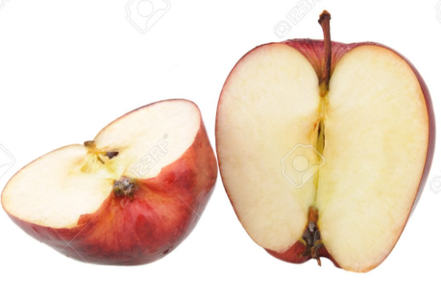
Fractions
Reception: Which fruit has been cut into 2 pieces (half)?

Slide 17
Fractions
Year 1: 8 cupcakes are shared between 4 plates (quarters). How many on each plate?

Slide 18
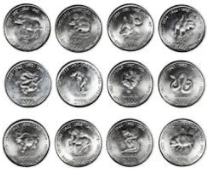
Fractions
Year 2: Tico gets ¼ of 12 coins.
How many coins does he get?
Year 3: Which is more 2/3 or 2/4 ?
Year 4: What is 1/5 of 25?
Adult Question: What is 3/5 of 30?

Slide 19
Fractions
Year 2: Tico gets ¼ of 12 coins.
How many coins does he get?
Year 3: Which is more 2/3 or 2/4 ?
Year 4: What is 1/5 of 25?
Adult Question: What is 3/5 of 30?

Slide 20
Times Tables Challenge!
You have 1 min to solve the questions on your challenge sheet!

Slide 21
Shape and Space
Reception: Can you name this shape?

Slide 22
Shape and Space
Year 1: How many triangles are in this picture?

Slide 23
Shape and Space
Year 2: Which letter has 2 lines of symmetry?
T H E
Year 3: What is the name of an eight sided shape?

Slide 24
Shape and Space
Year 4: Name 2 shapes that have a right angle in them.
Adult Question: What do the angles of a triangle always add up to?

