Slide 1
RWI Phonics Parent Meeting

Slide 2
Why Phonics?
A complete literacy programme - systematic and structured.
Meets the demands of the new Early Foundation Stage and the new national curriculum, giving your children the best chance of success in the national tests.
One-to-one tutoring - no child is left behind.
Storybooks align with the sounds learnt in class.

Slide 3
A bit of technical knowledge…
Phonics = the sounds in our language.
Key to successful phonic learning is the way sounds are pronounced.
https://www.youtube.com/watch?v=TkXcabDUg7Q

Slide 4
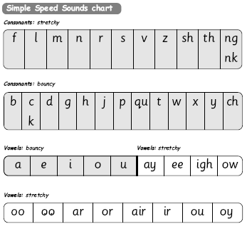

Slide 5
How does it work?
Children:
Learn 44 sounds and matching letters. Use picture cards to teach this which also supports letter formation. This is what we’re doing now in class. Lessons available to watch soon.
Learn to blend sounds to read words.
Read lots of specially written books.
This is decoding.

Slide 6
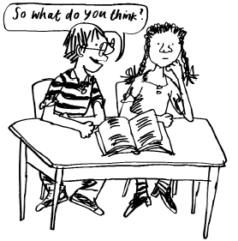
How does it work?
Children:
Talk a lot about what they have read to show they understand.
Listen to and discuss other ideas to deepen understanding.
This is comprehending.

Slide 7
The English language is a complex code…
It would be easy if we only had to learn Set 1 and Set 2 sounds. But, often one sound can be represented in many different ways. For example:
ay | igh
play eight cake straight | right pie kite fly

Slide 8
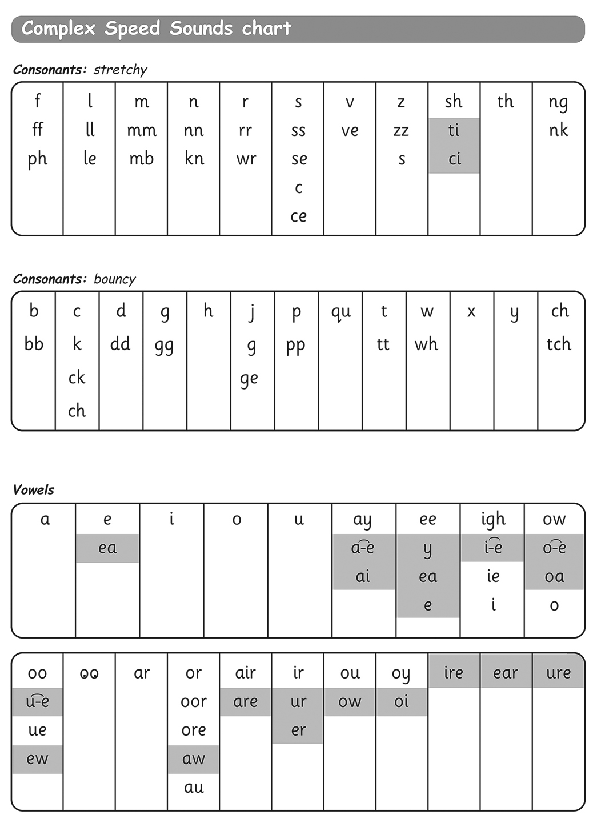

Slide 9
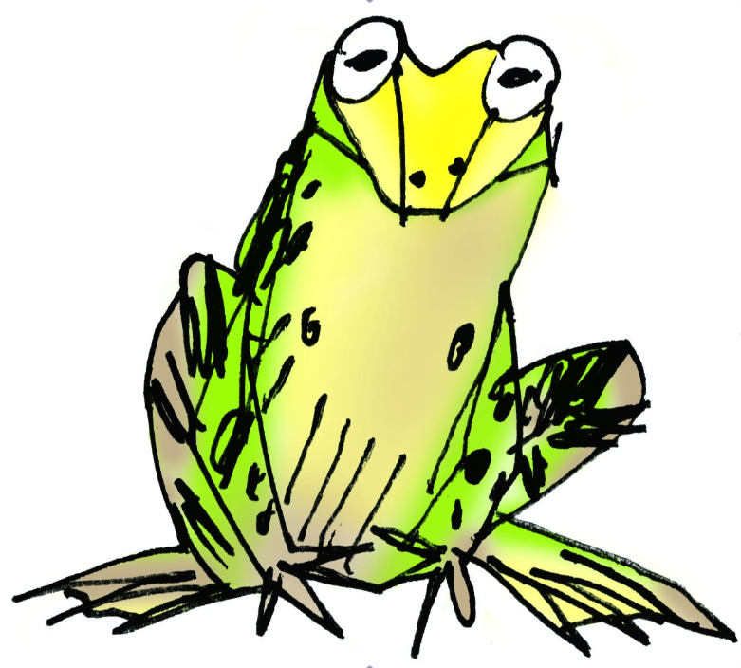
How do phonics help us read?
Say “hello” to Fred.
Fred can only talk in sounds...
He says “c_a_t.” Not cat.
We call this Fred Talk and this is how we teach children to blend sounds to read.
https://www.youtube.com/watch?v=dEzfpod5w_Q

Slide 10
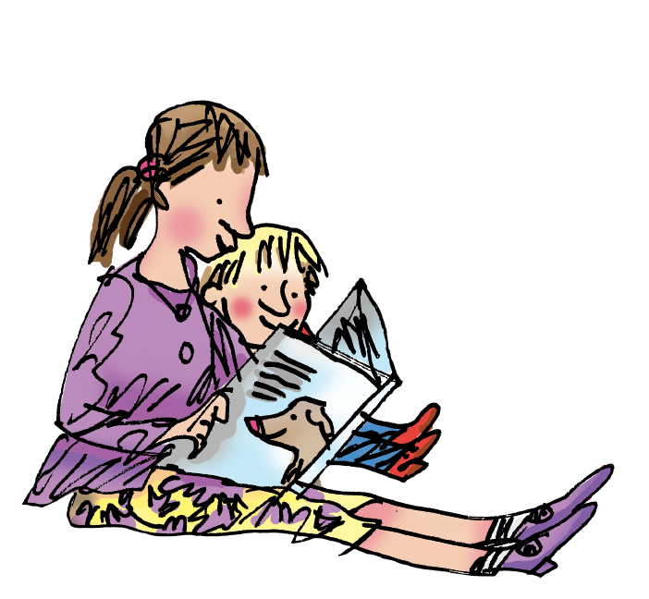
How to help your child at home…
Once children have been taught all of the set 1 sounds and can confidently blend to read simple words, they will move onto Read Write Inc books.

Slide 11
Green, Red and Alien Words and Ditty Books
What are ditty books?
Green words – Fred talk used to decode.
Red words – Fred talk doesn’t apply. Children learn to read them by sight.
Alien words – Fred talk used to decode. What a lot of nonsense! Let’s have a go!

Slide 12
You can read stories with your child. Relentlessly.
Read favourite stories over and over again.
Read some stories at a higher level than they can read themselves.
Listen to them reading their home reading books.
Notes:
View the Ruth Miskin Training suggested reading lists for great books to read with your children.
http://www.ruthmiskintraining.com/teacher-support/tag-44/index.html

Slide 13
And...
Asking lots of questions!
Use these prompts to help you:
What is that character thinking?
What do you think
happens next?
What is happening?
What do you
think that character is
feeling now?
What is the character saying?

Slide 14
And...
By talking to your child as much as possible and ‘feeding’ them new and different words:
“Let’s eat our lunch now.”
“Let’s munch our lunch now.”
“Let’s scoff our lunch now.”
“Let’s devour our lunch now!”

Slide 15
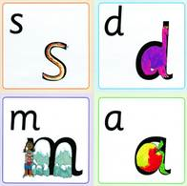
You can practise pronouncing sounds.
Remember no ‘fuh’ and ‘luh’!

Slide 16
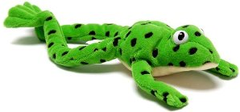
You can have fun with Fred Talk.
“What a tidy r-oo-m!”
“Where’s your c-oa-t?”
“Time for b-e-d!”

Slide 17
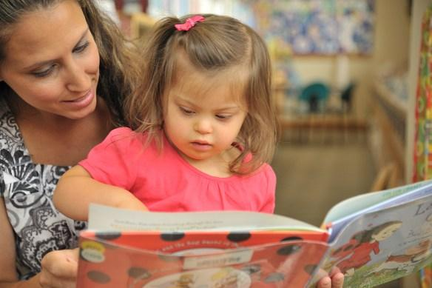
Thank you...
Happy reading!
Thank you for coming.

